Slide 1
{Title}
{Text}
Notes:
Title

Slide 2
{Title}
{Text}
Notes:
Title Text 1

Slide 3

{Title}
{Text}
Notes:
Title Text 2

Slide 4
{Title}
{Text}
Notes:
Title Text 3

Slide 5

{Title}
{Text}
Notes:
Prayer of Confession

Slide 6
THE LORD’S PRAYER
Our Father in heaven,
Hallowed be Your name.
Your kingdom come,
Your will be done,
On Earth as it is in heaven.
Give us this day our daily bread.

Slide 7
THE LORD’S PRAYER
And forgive us our debts,
as we also have forgiven our debtors.
And lead us not into temptation,
but deliver us from evil.
For Yours is the kingdom, the power,
the glory, forever.
Amen

Slide 8
HOLY COMMUNION
Notes:
Benediction

Slide 9
1 CORINTHIANS 11:23-29
²³ For I received from the Lord what I also delivered to
you, that the Lord Jesus on the night when he was
betrayed took bread,
²⁴ and when he had given thanks, he broke it, and
said, “This is my body, which is for you. Do this in
remembrance of me.”
²⁵ In the same way also he took the cup, after supper,
saying, “This cup is the new covenant in my blood.
Do this, as often as you drink it, in remembrance of
me.”
Notes:
Title Text 3

Slide 10
1 CORINTHIANS 11:23-29
²⁶ For as often as you eat this bread and drink the cup,
you proclaim the Lord’s death until he comes.
²⁷ Whoever, therefore, eats the bread or drinks the cup
of the Lord in an unworthy manner will be guilty
concerning the body and blood of the Lord.
²⁸ Let a person examine himself, then, and so eat of the
bread and drink of the cup.
²⁹ For anyone who eats and drinks without discerning
the body eats and drinks judgment on himself.
Notes:
Title Text 3

Slide 11
APOSTLE’S CREED
I believe in God, the Father almighty, the creator of heaven and earth. I believe in Jesus Christ, his only Son, our Lord, who was conceived by the Holy Spirit and born of the virgin Mary. He suffered under Pontius Pilate, was crucified, died, and was buried; he descended to hell. The third day he rose again from the dead.

Slide 12
APOSTLE’S CREED
He ascended to heaven and is seated at the right hand of God the Father almighty. From there he will come to judge the living and the dead. I believe in the Holy Spirit, the holy catholic church, the communion of saints, the forgiveness of sins, the resurrection of the body and the life everlasting. Amen.

Slide 13
{Title}
{Text}
Notes:
Sermon Title

Slide 14
OFFERING
“Each of you should give what you have decided in your heart to give, not reluctantly or under compulsion, for God loves a cheerful giver.”
—2 Corinthians 9:7
Notes:
Offering

Slide 15
DOXOLOGY
Praise God, from whom all blessing flow
Praise Him, all creatures here below
Praise Him above, ye heavenly hosts
Praise Father, Son and Holy Ghost
Amen
Notes:
Doxology

Slide 16
BENEDICTION
Notes:
Benediction

Slide 17
NEXT WEEK’S SCHEDULE
 | {Date}
Speaker | {Speaker}
Worship Leader | {Leader}
Accompanist | {Accompanist}
Streaming | {Streaming}
Announcer | {Announcer}
Notes:
Next Week’s Schedule

Slide 18

{Title}
{Text}
Notes:
Hymn 1

Slide 19
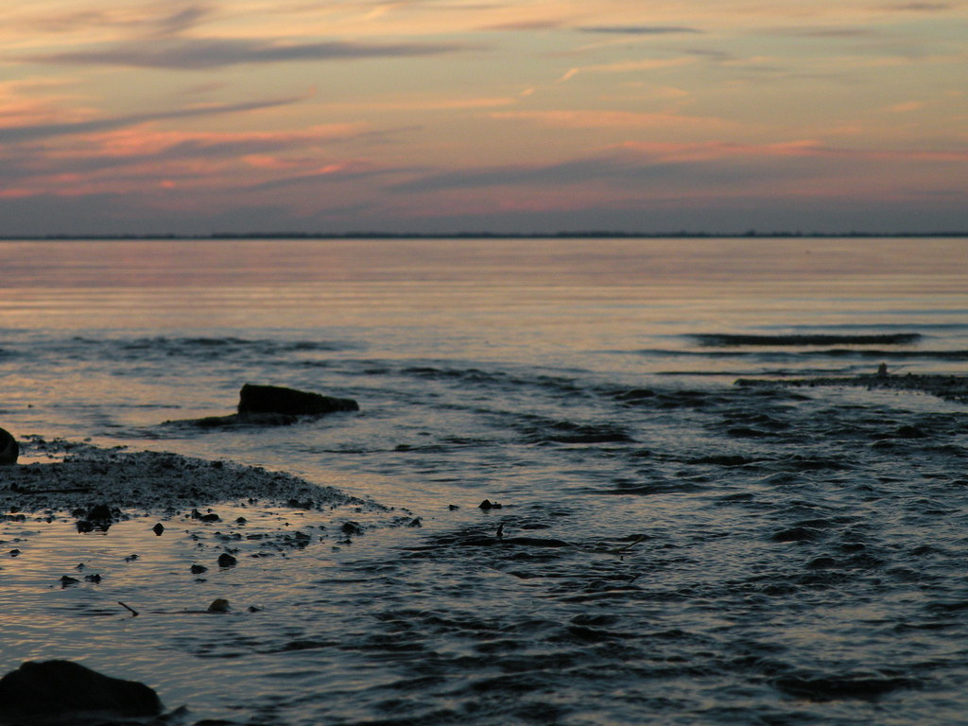
{Title}
{Text}
Notes:
Hymn 3

Slide 20
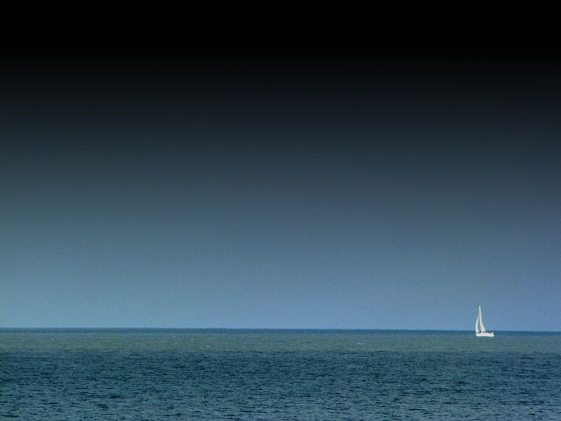
{Title}
{Text}
Notes:
Hymn 2

Slide 21

{Title}
{Text}
Notes:
Hymn 4

Slide 22

{Title}
{Text}
Notes:
Hymn 4

Slide 23
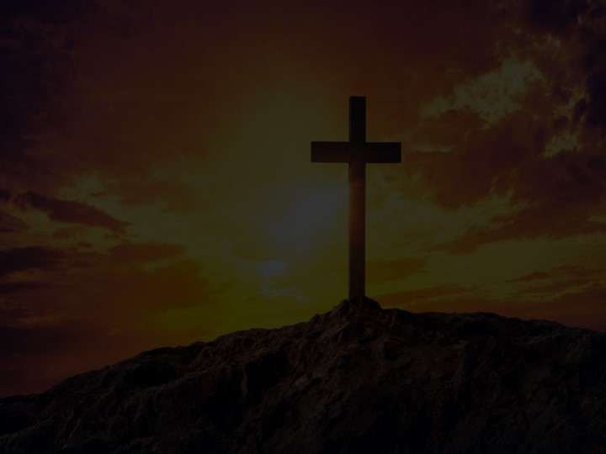
{Title}
{Text}
Notes:
Hymn 4

Slide 24

{Title}
{Text}
Notes:
Hymn 4

Slide 25
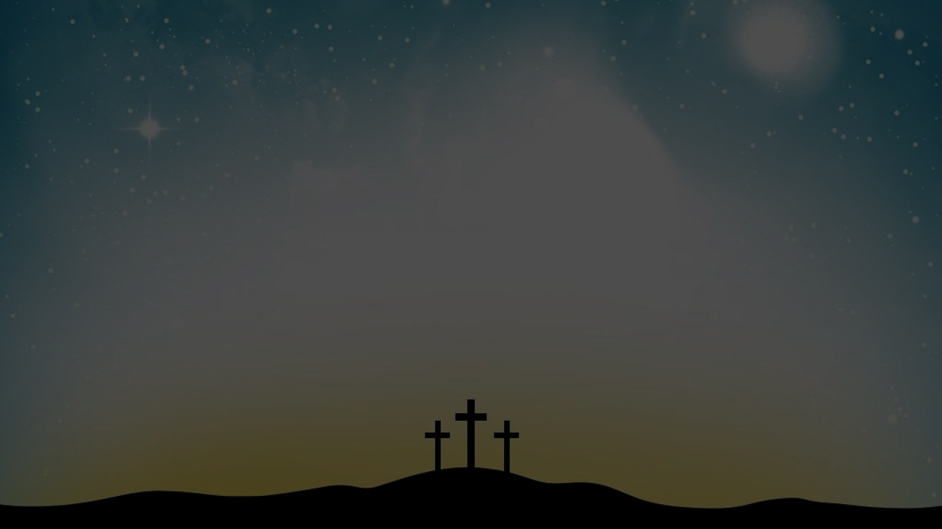
{Title}
{Text}
Notes:
Hymn 4

Slide 26
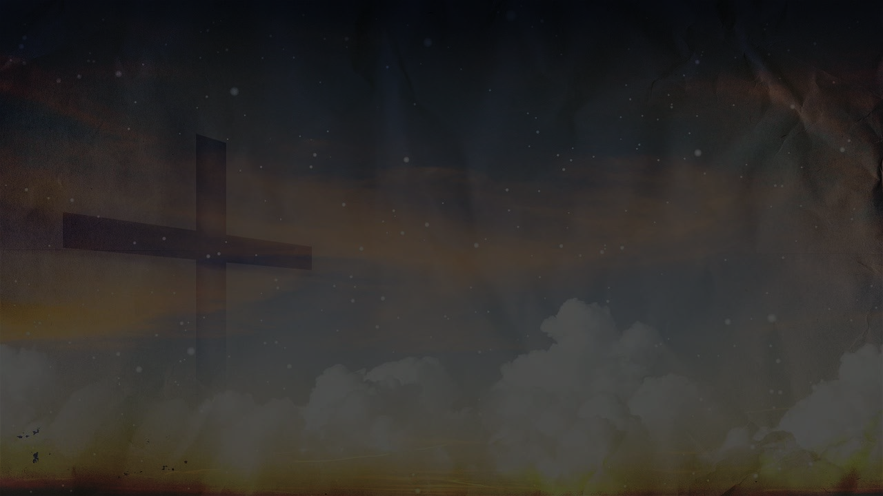
{Title}
{Text}
Notes:
Hymn 4

Slide 27

{Title}
{Text}
Notes:
Hymn 4

Slide 28

{Title}
{Text}
Notes:
Hymn 4

Slide 29
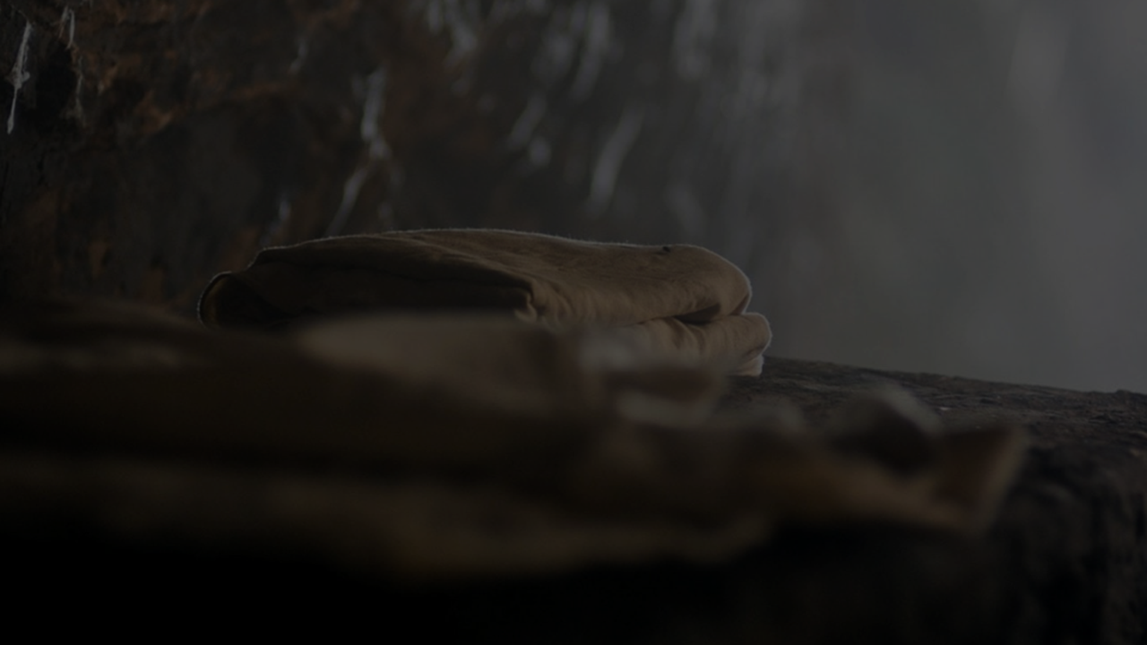
{Title}
{Text}
Notes:
Hymn 4

